Slide 1




Formula SAE Suspension
67% Hardware Update
Parker Johnson: Suspension Design Lead
Chris Laney: Brakes Engineer
Garrett Pearson: A-Arm Engineer
Mathew Cusson: Steering Engineer
Joseph Ciao: Pushrod Assembly Engineer
Page 1

Slide 2
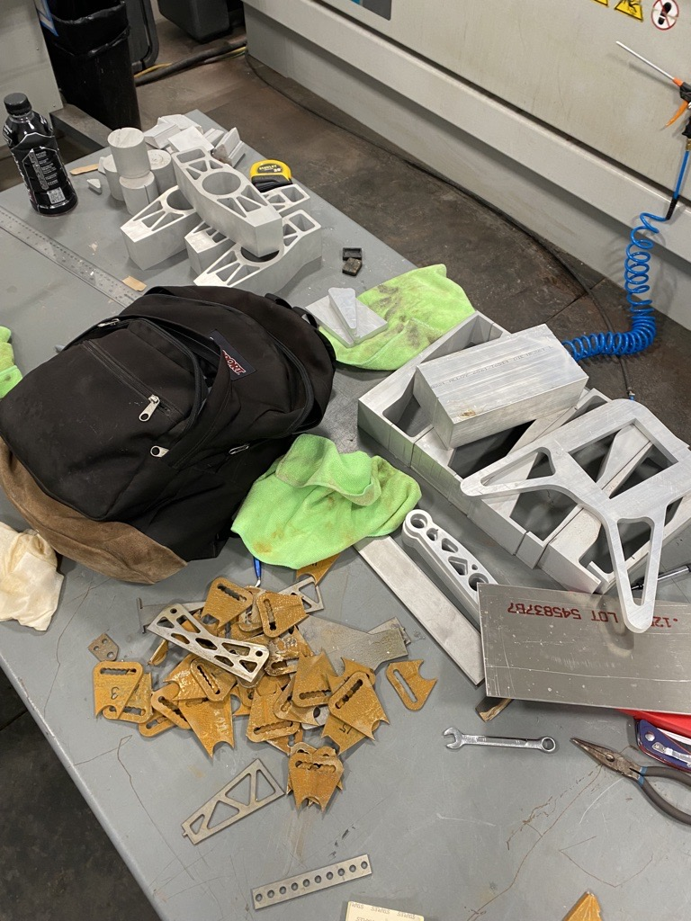
Design Efforts/Changes Overview
Brakes
Rotor design analyzed in-depth and finalized
Everything cut and in hand, just needs to be assembled
Primarily welding pedal box
Knuckles/Hubs
Machining remaining 2 knuckles
Finish Mill operations on hubs
Pushrod Assembly
Front and Rear Rocker, parts cut and milled to size
Finalized Rocker Spacer Design, analysis done
Manufacturing spacers on lathe
A-Arms:
Started welding front arms
Modifying rear jigs for welding on Thursday
Steering:
Lower half of column machined, finalizing top half
Page 2: Joe

Slide 3
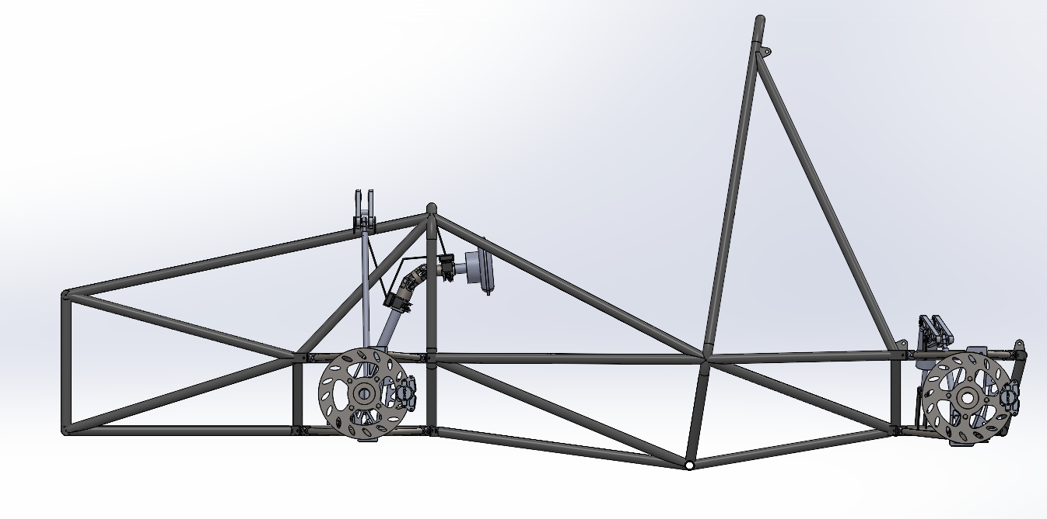
Design Efforts/Changes
Page 3: Matthew

Slide 4
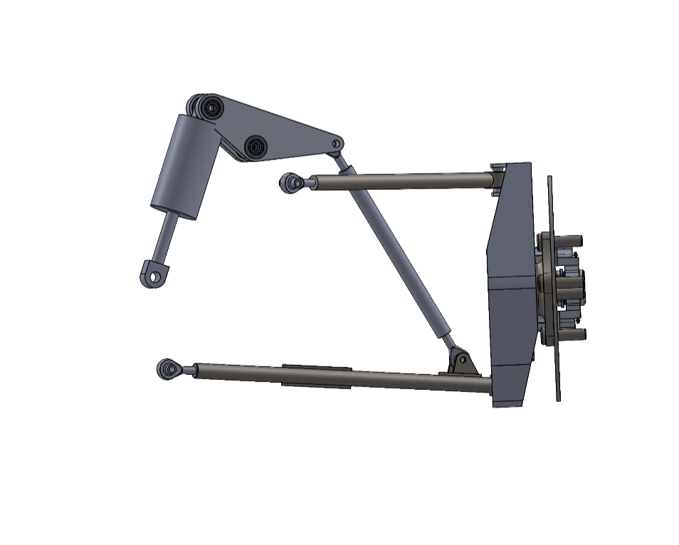
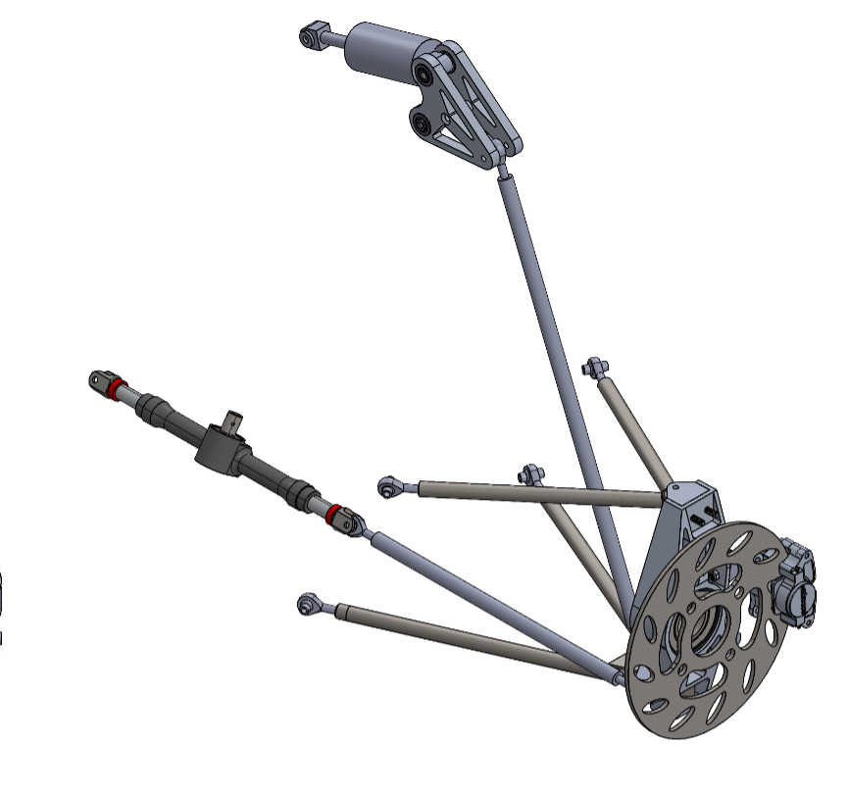
Design Efforts/Changes
Page 4: Matthew

Slide 5
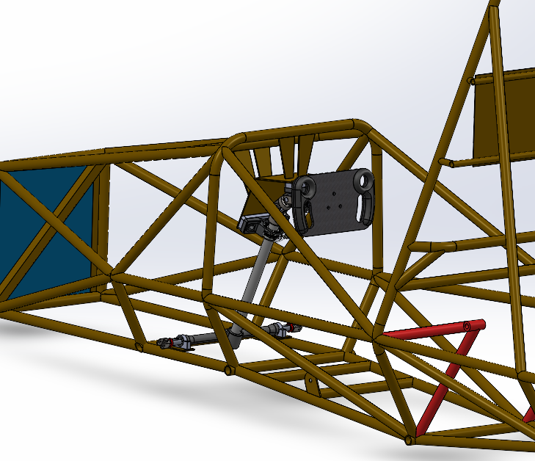
Design Efforts/Changes
Page 5: Matthew

Slide 6
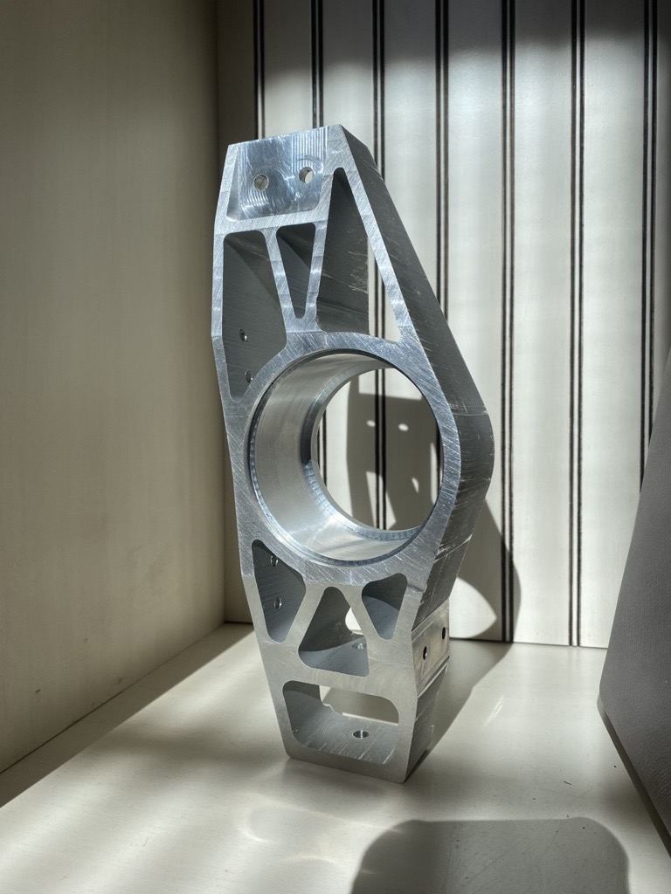
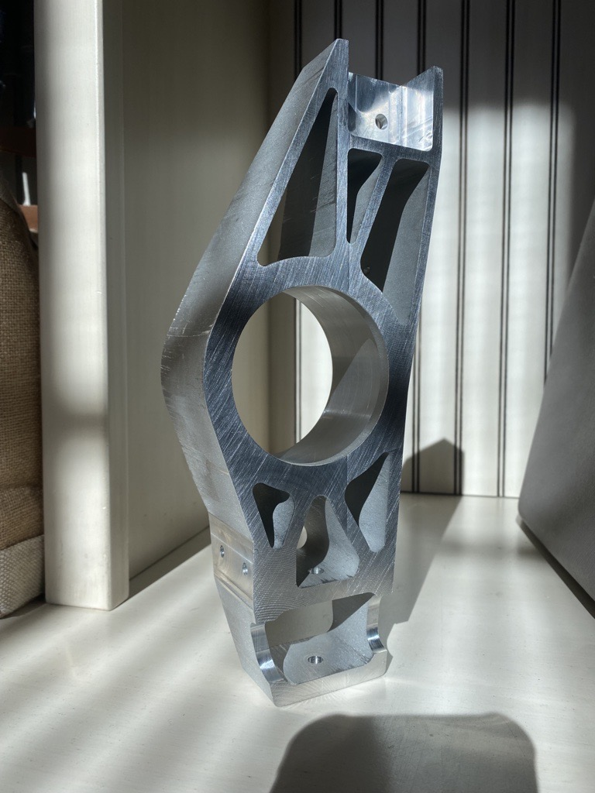
Design Efforts/Changes
Page 6: Parker

Slide 7
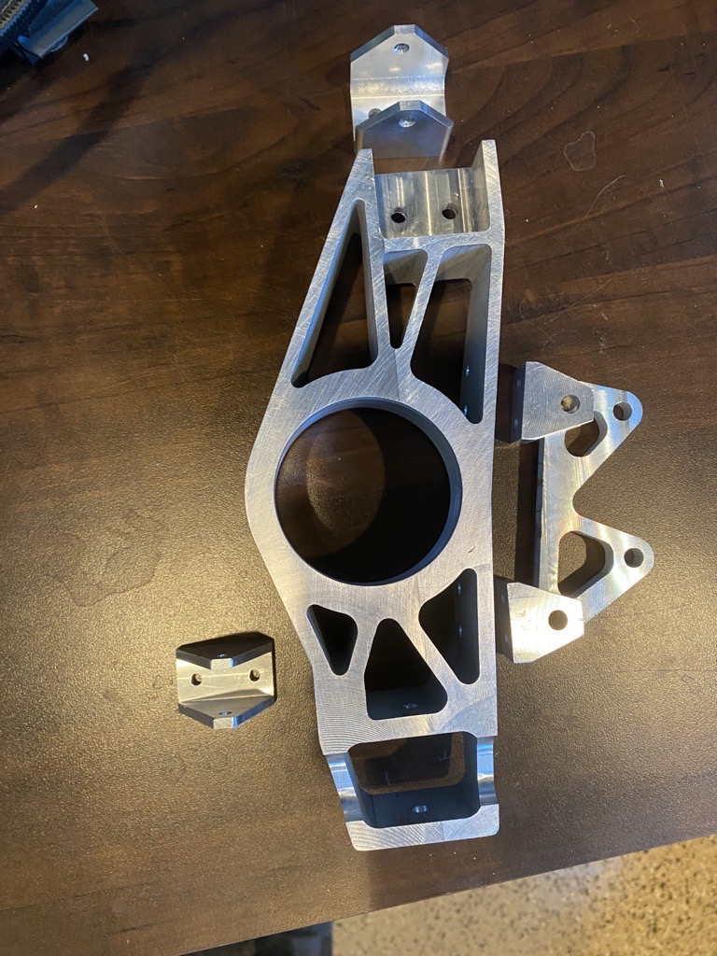
Design Efforts/Changes
Page 7: Parker

Slide 8
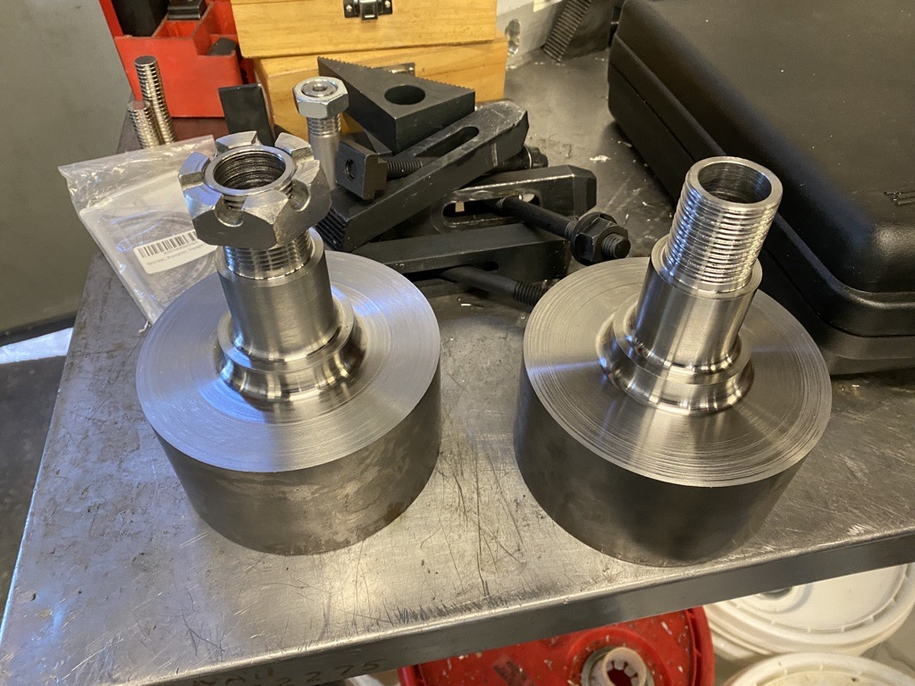
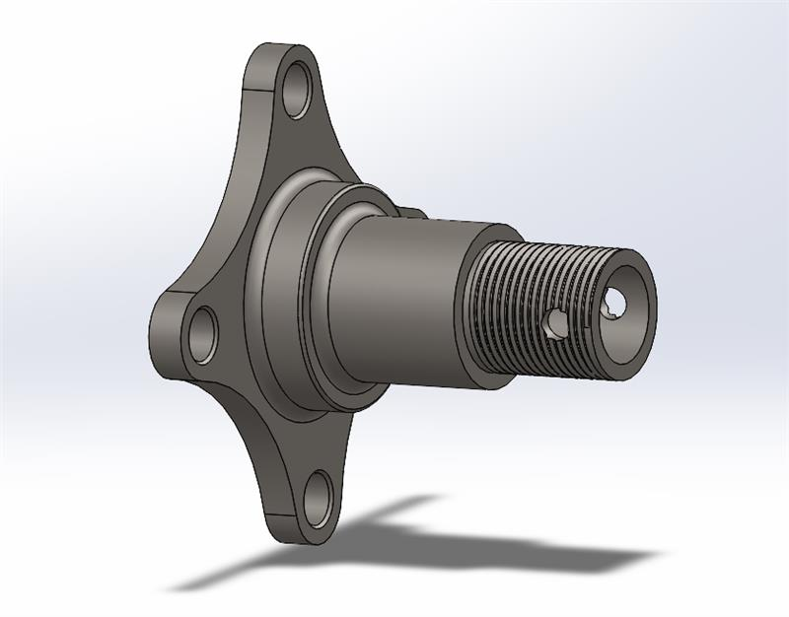
Design Efforts/Changes
Page 7: Parker

Slide 9
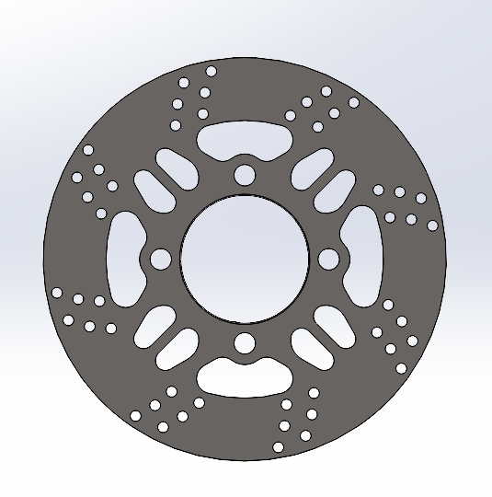
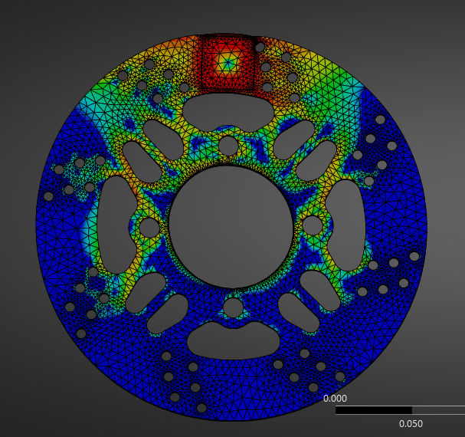
Design Efforts/Changes
Page 8: Chris

Slide 10
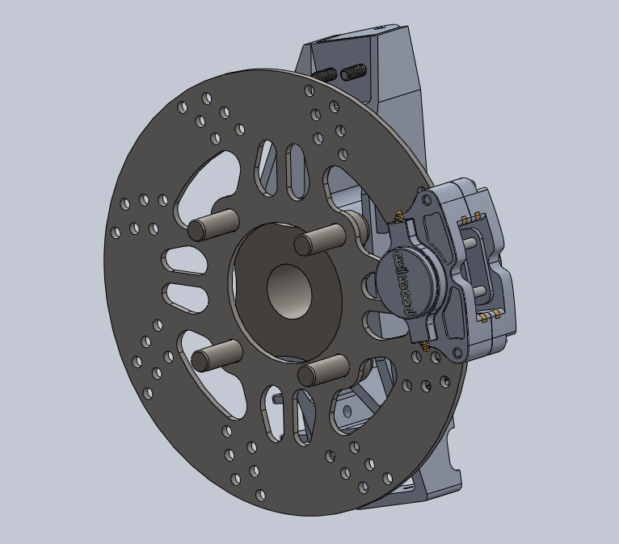
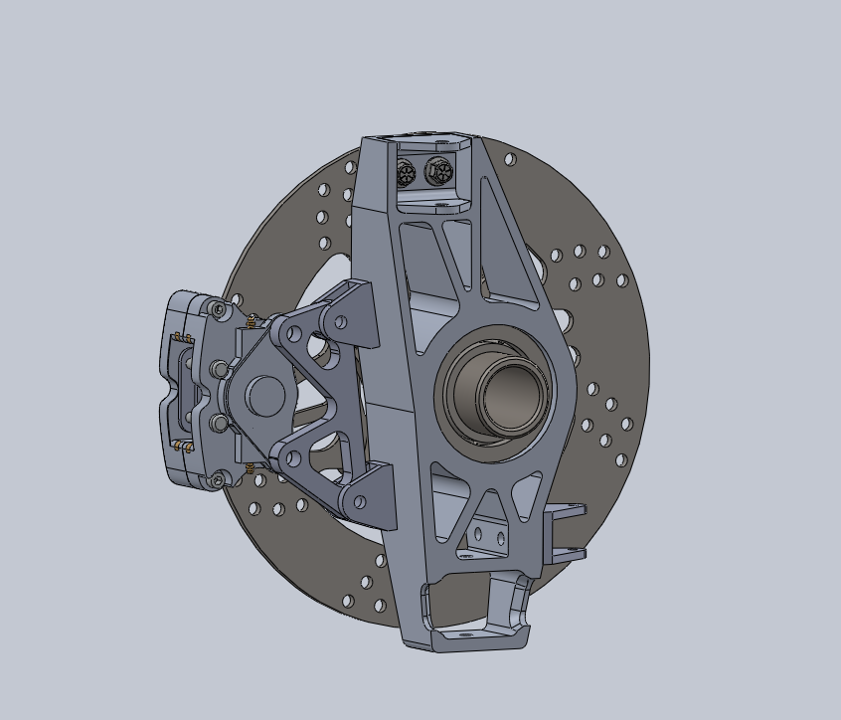
Design Efforts/Changes
Page 9: Chris

Slide 11
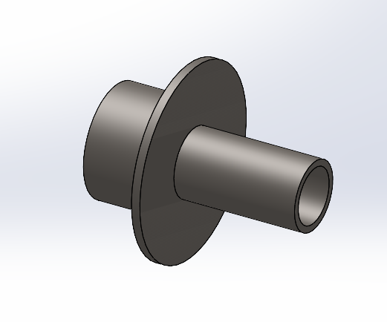
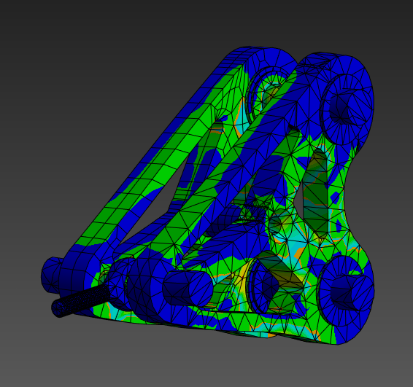
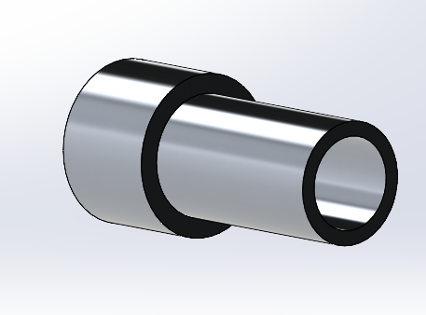
Design Efforts/Changes
Page 10: Joe

Slide 12
Manufacturing Plan
Part | Time | Manufacturing Method | Progress
Front Knuckles x 2 | 30 hours | Water Jet and Vertical Mill | 50% Complete
Rear Knuckles x 2 | 30 hours | Water Jet and Vertical Mill | 50% Complete
Front Wheel Hubs x 2 | 6 hours | Outsource | 50% (milling operation left) ~1 day
Tie Rods | 1 Hours | Cutting and Welding | 0% (need to be cut to length)
Front Control Arms | 8 Hours | Welding | 95% (need welding)
Rear Control Arms | 8 Hours | Welding | 40% (jigs made)
Threaded Inserts | 8 Hours | Lathe | 100% Complete
Steering Column Shafts | 3 Hours | Lathe and Mill | 50%
Column Spacers | 1 Hour per Spacer | Band Saw and Drill Press | 100% (more will likely be made)
Column Mount | .5 Hours | Water Jet and welding | 50% (water jet complete)
Rocker Arm Spacers | 8 hours | Lathe | 0%
Page 11: Garrett Pearson

Slide 13
Manufacturing Plan
Part | Time | Manufacturing Method | Progress
Front brake caliper bracket | 2 hours | Water Jet and Vertical Mill | Complete
Rear brake caliper bracket | 2 hours | Water jet and Vertical Mill | Complete
Pedal box | 3 hours | Water jet + welding | Parts cut and prepped to weld, 66% complete
Rotors | 3 hours | Water jet + finishing | Complete
Caliper Bracket -> Knuckle bracket x 4 | 5 hours | Vertical Mill | Complete
Control Arm -> Knuckle Bracket x 2 | 5 hours | Vertical mill | 70% Complete
Knuckle -> Tie rod bracket x 2 | 3 hours | Vertical mill | 80% Complete
Rocker Arms |  | Water Jet and Mill | 100% Complete
Pushrods x 4 | 2 hours | Cutting/ welding | 0% Complete
Page 12: Garrett Pearson Suspension: 67%; Steering: 63%; Brakes: 94%; Total: 74% Complete

Slide 14
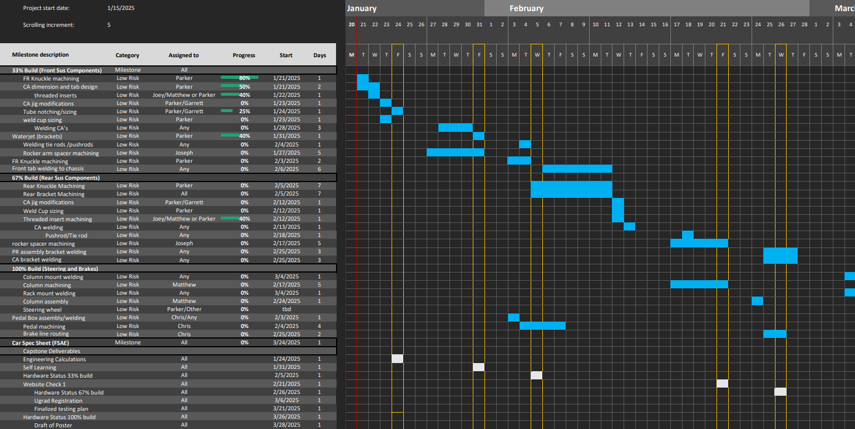
Gantt Chart
Page 13: Parker

Slide 15
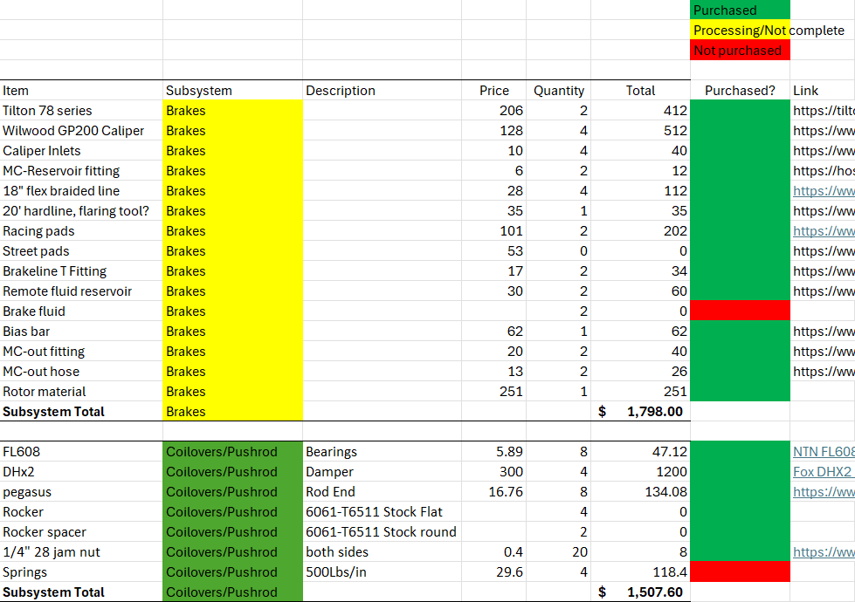
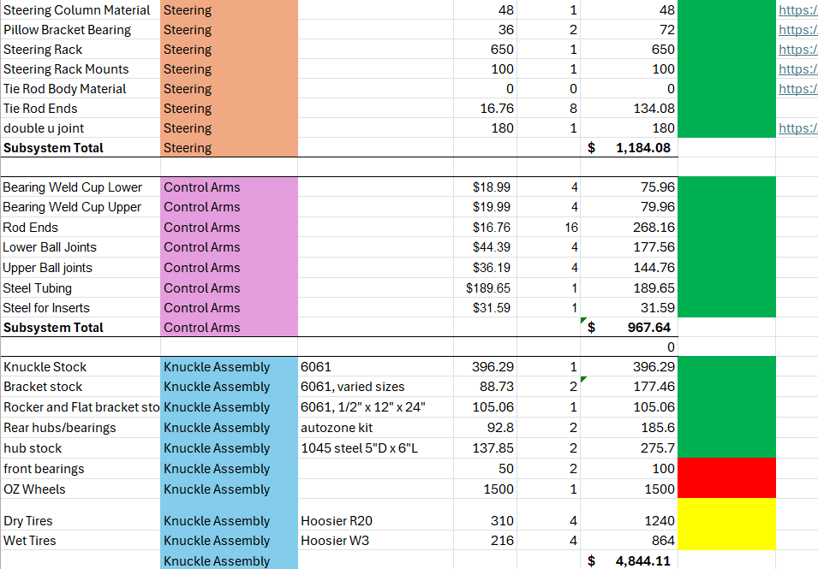
Purchasing Plan/BOM
95% bought, 90% delivered; waiting on springs, need to purchase wheels and tires
Page 14: Chris

Slide 16
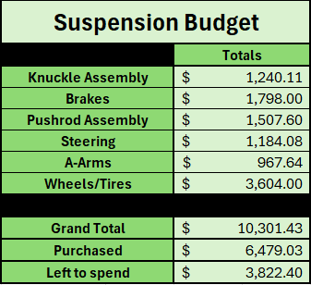
Purchasing Plan/BOM
Page 14: Parker

Slide 17


Thank you!

